Slide 1

Design & Analysis of Algorithm
CS-503
Computer Science
Lecture 1
Introduction of Algorithms
BY: Bushra Saif

Slide 2
What is course about?
The theoretical study of design and analysis of computer algorithms
Basic goals for an algorithm:
Always correct
Always terminates
This class: Performance
L1.<number>

Slide 3
Algorithm
“A finite set of instruction that specifies a sequence of operation is to be carried out in order to solve a specific problem or class of problems is called an Algorithm“
If we have an algorithm for a specific problem, then we can implement it in any programming language, meaning that the algorithm is independent from any programming languages.
L1.<number>

Slide 4
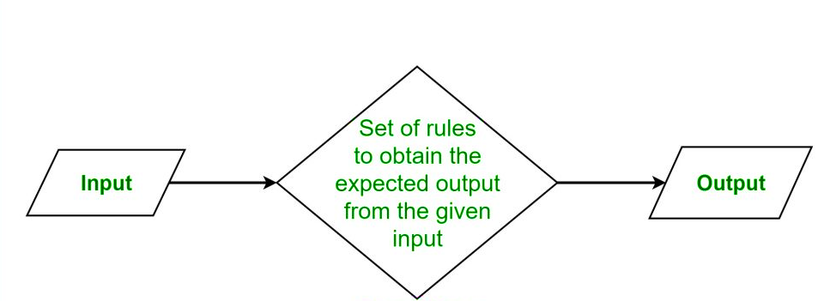
Algorithm
L1.<number>

Slide 5
Algorithm Characteristics
Unambiguous: Each of its steps (or phases), and their input/outputs should be clear and must lead to only one meaning.
example:- 2+3*4=14 ← always answer is same.
Input: An algorithm should have 0 or more well defined inputs.
Output: An algorithm should have 1 or more well defined outputs, and should match the desired output.
Finite-ness: Algorithms must terminate after a finite number of steps.
Feasibility: Should be feasible with the available resources.
Independent: An algorithm should have step-by-step directions which should be independent of any programming code.
L1.<number>

Slide 6
Types of Algorithms
Algorithms are classified based on the concepts that they use to accomplish a task. While there are many types of algorithms, the most fundamental types of computer science algorithms are:
Divide and conquer algorithms – divide the problem into smaller sub problems of the same type; solve those smaller problems, and combine those solutions to solve the original problem.
Brute force algorithms – try all possible solutions until a satisfactory solution is found.
L1.<number>

Slide 7
Types of Algorithms
Randomized algorithms – use a random number at least once during the computation to find a solution to the problem.
Greedy algorithms – find an optimal solution at the local level with the intent of finding an optimal solution for the whole problem.
Recursive algorithms – solve the lowest and simplest version of a problem to then solve increasingly larger versions of the problem until the solution to the original problem is found.
L1.<number>

Slide 8
Types of Algorithms
Dynamic programming algorithms – break a complex problem into a collection of simpler sub problems, then solve each of those sub problems only once, storing their solution for future use instead of re-computing their solutions.
Backtracking algorithms – divide the problem into sub problems, each which can be attempted to be solved; however, if the desired solution is not reached, move backwards in the problem until a path is found that moves it forward.
L1.<number>

Slide 9
Algorithm Design
Designing an algorithm is important before writing the program code as the algorithm explains the logic even before the code is developed.
The important aspects of algorithm design include creating an efficient algorithm to solve a problem in an efficient way using minimum time and space.
Both time consumption and memory usage cannot be optimized simultaneously.
L1.<number>
Notes:
If we require an algorithm to run in lesser time, we have to invest in more memory and if we require an algorithm to run with lesser memory, we need to have more time.

Slide 10
Algorithm Example
START
Declare 3 integer variables num1, num2 and num3.
Take the three numbers, to be added, as inputs in variables num1, num2, and num3 respectively.
Declare an integer variable sum to store the resultant sum of the 3 numbers.
Add the 3 numbers and store the result in the variable sum.
Print the value of variable sum
END
L1.<number>

Slide 11
Advantages of an Algorithm
It is easy to understand.
Algorithm is a step-wise representation of a solution to a given problem.
In Algorithm the problem is broken down into smaller pieces or steps hence, it is easier for the programmer to convert it into an actual program
Disadvantages of an Algorithms
Writing an algorithm takes a long time so it is time-consuming.
Branching and Looping statements are difficult to show in Algorithms.
L1.<number>

Slide 12
Pseudocode
It is one of the methods which can be used to represent an algorithm for a program.
It does not have a specific syntax like any of the programming languages and thus cannot be executed on a computer.
There are several formats which are used to write pseudo-codes and most of them take down the structures from languages such as C, FORTRAN, etc.
Pseudocode allows you to include several control structures such as While, If-then-else, Repeat-until, for and case, which is present in many high-level languages
L1.<number>

Slide 13
Pseudocode Example
READ three numbers and store in n1, n2, n3
IF n1>n2
IF n1>n3
WRITE “n1 is maximum”
ELSE
WRITE “n3 is maximum”
ENDIF
ELSE
IF n2>n3
WRITE “n2 is maximum”
ELSE
WRITE “n3 is maximum”
ENDIF
L1.<number>
Notes:
In the above pseudocode, we first take three inputs from user and store them in n1, n2 and n3. Then check whether n1 is greater than n2. If n1 is greater than n2, then check again whether n1 is also greater than n3. If yes, Print “n1 is max”, else Print “n3 is max”. But if first condition i.e n1>n2 is false, we need to again check whether n2 is greater than n3, If yes then we print “n2 is Maximum” else we Print “n3 is maximum”.

Slide 14
Analysis of algorithm
The analysis is a process of estimating the efficiency of an algorithm.
WHY
Algorithms are often quite different from one another, though the objective of these algorithms may same. For example, we know that a set of numbers can be sorted using different algorithms.
Number of comparisons performed by one algorithm may vary with others for the same input. Hence, time complexity of those algorithms may differ. At the same time, we need to calculate the memory space required by each algorithm.
L1.<number>

Slide 15
Analysis of algorithm
There are two fundamental parameters based on which we can analysis the algorithm:
Space factor: The space complexity can be understood as the amount of space required by an algorithm to run to completion.
Time factor: Time complexity is a function of input size n that refers to the amount of time needed by an algorithm to run to completion.
The time is measured by counting the number of key operations such as comparisons in sorting algorithm.
L1.<number>

Slide 16
Priori Analysis
Hence Priori analysis means checking the algorithm before its implementation. In this, the algorithm is checked when it is written in the form of theoretical steps.
This Efficiency of an algorithm is measured by assuming that all other factors, for example, processor speed are constant and have no effect on the implementation. This is done usually by the algorithm designer. It is in this method, that the Algorithm Complexity is determined.
L1.<number>

Slide 17
Posterior Analysis
Hence Posterior analysis means checking the algorithm after its implementation. In this, the algorithm is checked by implementing it in any programming language and executing it. This analysis helps to get the actual and real analysis report about correctness, space required, time consumed etc.
L1.<number>

Slide 18
Space Complexity
The space complexity of an algorithm is calculated by determining following two components:
Fixed Part: This refers to the space that is definitely required by the algorithm. For example, input variables, output variables, program size, etc.
Variable Part: This refers to the space that can be different based on the implementation of the algorithm. For example, temporary variables, dynamic memory allocation, recursion stack space, etc.
L1.<number>

Slide 19
Time Complexity
Time requirements can be defined as a numerical function T(n), that can be normal operations, conditional if-else statements, loop statements, etc. The time complexity of an algorithm is calculated by determining following two components:
Constant time part: Any instruction that is executed just once comes in this part. For example, input, output, if-else, switch, etc.
Variable Time Part: Any instruction that is executed more than once, say n times, comes in this part. For example, loops, recursion, etc.
L1.<number>

Slide 20
Time Complexity Analysis
Worst case: For 'n' input size, the worst-case time complexity can be defined as the maximum amount of time needed by an algorithm to complete its execution.
Average case: For 'n' input size, the average-case time complexity can be defined as the average amount of time needed by an algorithm to complete its execution.
Best case: For 'n' input size, the best-case time complexity can be defined as the minimum amount of time needed by an algorithm to complete its execution.
Thus, it is nothing but a function defined by the max./average/min. number of steps performed on an instance having an input size of n.
L1.<number>

Slide 21
Example
Suppose you are given an array A and an integer x and you have to find if exists in array A.
Simple solution to this problem is traverse the whole array A and check if the any element is equal to x .
  for i : 1 to length of A
  if A[i] is equal to x
  return TRUE
  return FALSE
L1.<number>

Slide 22
Example – explanation
Each of the operation in computer take approximately constant time c. The number of lines of code executed is actually depends on the value of x. During analyses of algorithm, mostly we will consider worst case scenario, i.e., when is not present in the array A. In the worst case, the if condition will run N times where N is the length of the array . So in the worst case, total execution time will be (N* c+ c). N* c for the if condition and c for the return statement.
As we can see that the total time depends on the length of the array A. If the length of the array will increase the time of execution will also increase.
L1.<number>

Slide 23
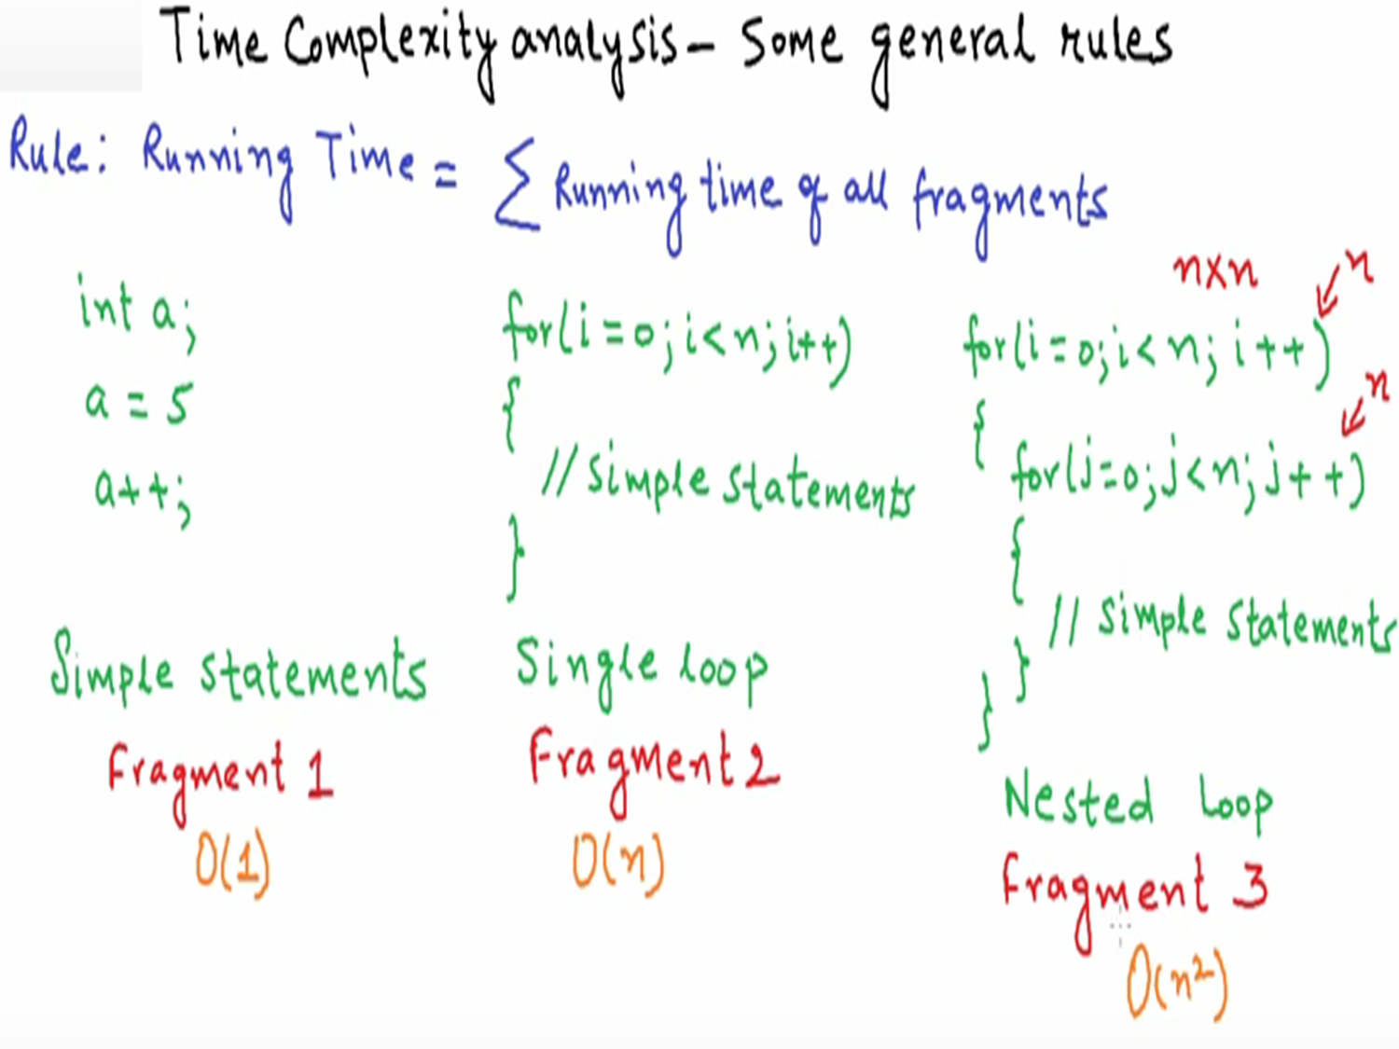
L1.<number>

Slide 24
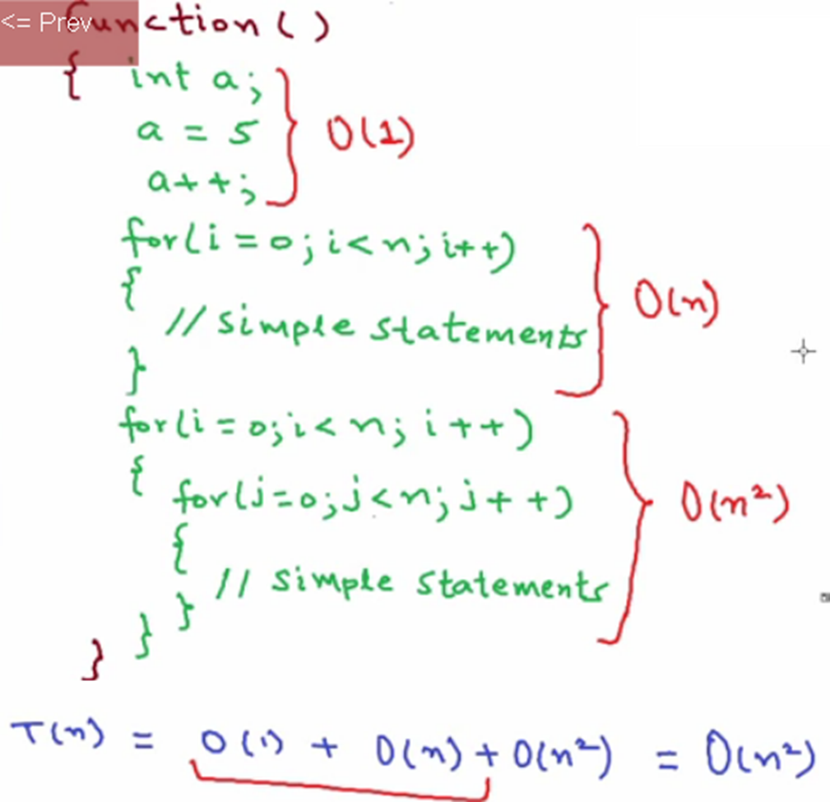
L1.<number>

Slide 25
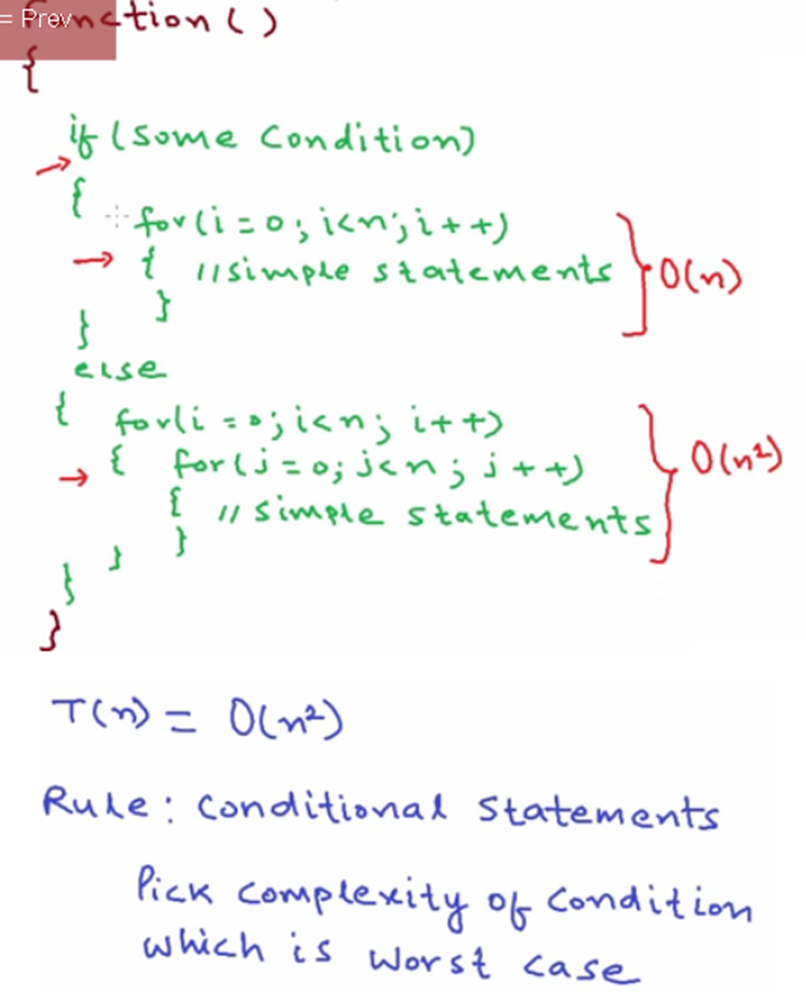
L1.<number>

